Slide 1
COMP6203 Intelligent Agents 2020/2021
Introduction
Dr Enrico Gerding
eg@ecs.soton.ac.uk

Slide 2
Outline
Topics covered today
Towards multi-agent systems: trends in Computer Science
What is an Agent?
Multi-Agent Systems
Agents and Related Concepts

Slide 3
Overview
Five ongoing trends have marked the history of computing:
ubiquity;
interconnection;
intelligence;
delegation; and
human-orientation

Slide 4

Ubiquity
The continual reduction in cost of computing capability has made it possible to introduce processing power into places and devices that would have once been uneconomic
As processing capability spreads, sophistication (and intelligence of a sort) becomes ubiquitous
There is increased amount of data becoming available, and processing of this data is increasingly done at the edge of the network, so-called edge computing

Slide 5

Interconnection
Computer systems today no longer stand alone, but are networked into large distributed systems
The internet is an obvious example
Since distributed and concurrent systems have become the norm, researchers are putting forward theoretical models that portray computing as primarily a process of interaction

Slide 6
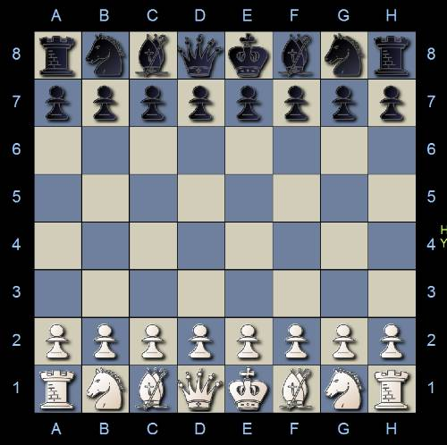
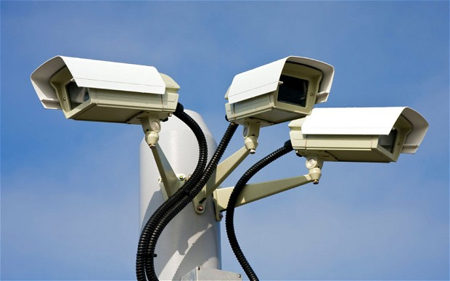

Intelligence
The complexity of tasks that we are capable of automating and delegating to computers has grown steadily
Many of these tasks are ones that can be thought of as requiring a good deal of intelligence.

Slide 7
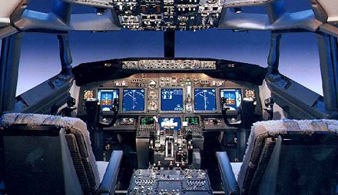
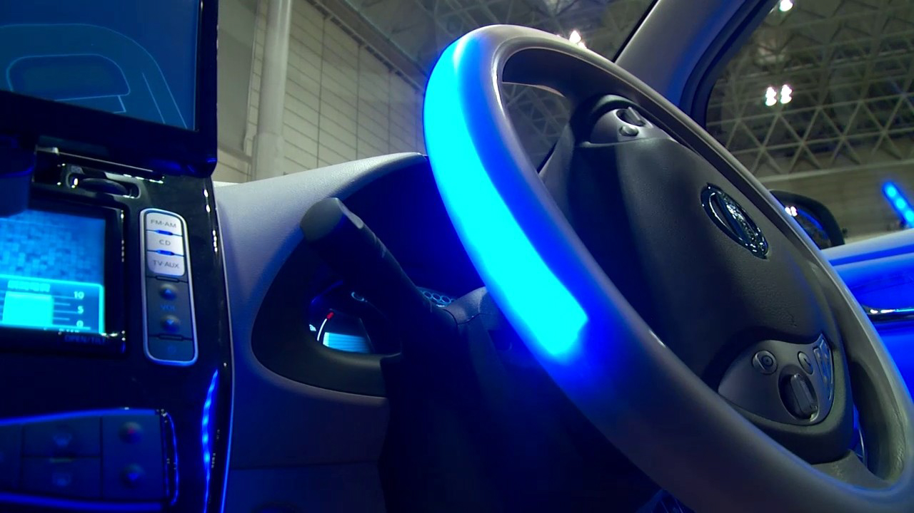
Delegation
Computers are doing more for us – without our intervention
We are giving control to computers, even in safety critical tasks, e.g.:
Fly-by-wire aircraft, where the machine’s judgment may be trusted more than an experienced pilot
Autonomous cars and public transport

Slide 8
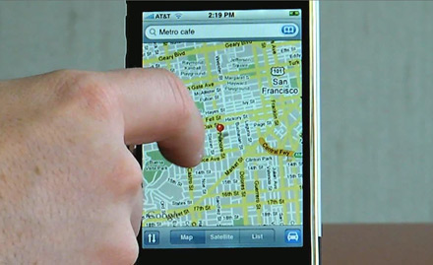
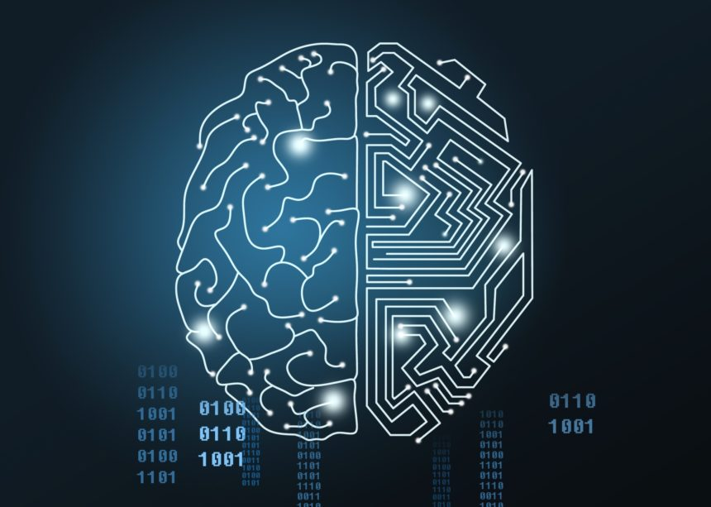
Human orientation
AI programs need input from humans: e.g. understanding preferences and for controlling and checking decisions
Explainable AI: Need higher level of abstractions to interact with complex systems, using familiar metaphors: cannot expect to understand how ‘engine‘ works to use it
AI is not only about automation, but about augmenting human’s intelligence

Slide 9
Where does it bring us?
Delegation and Intelligence imply the need to build computer systems that can act effectively on our behalf
This implies:
The ability of computer systems to act independently
The ability of computer systems to act in a way that represents our best interests while interacting with other humans or systems
In turn, this implies systems that can cooperate and reach agreements (or even compete) with other systems that have different interests (much as we do with other people)
Together, these trends have led to the emergence of a new field in computer science:
multi-agent systems

Slide 10
What is an agent?
“A computer system capable of autonomous action in some environment, in order to achieve its delegated goals”
The key points are:
Autonomy: capable of independent action without need for constant intervention
Delegation: acts on behalf of its user or owner
We think of an agent as being in a close-coupled, continual interaction with its environment:
sense — decide — act — sense — decide . . .

Slide 11
Agent and Environment
Perceives the environment through sensors
Acts on the environment through actuators
Sensors: camera, TCP/UDP socket, keyboard, . . .
Actuators: variable, web page, database, robotic arm, . . .

Slide 12
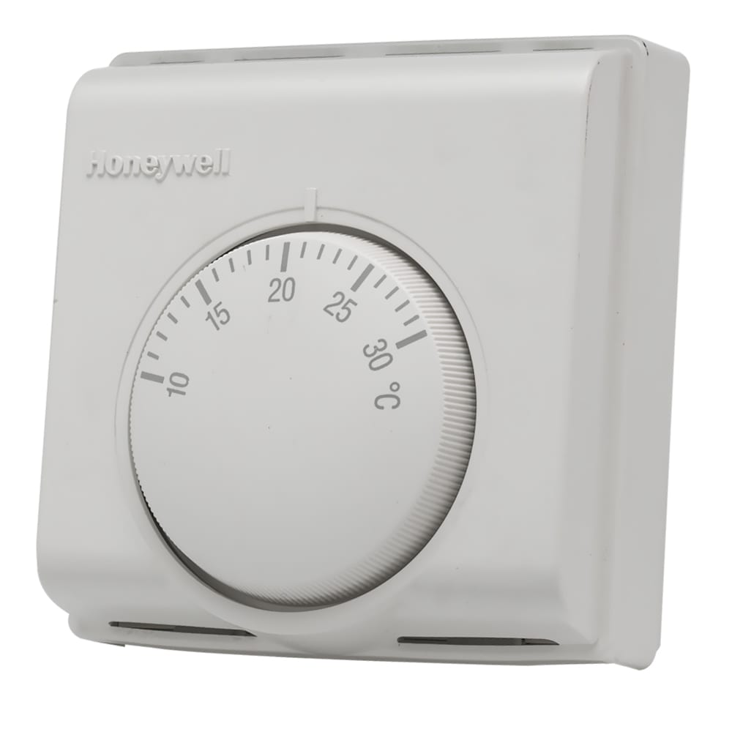
Simple (Uninteresting) Agents
(Traditional) Thermostat
Delegated goal is to maintain room temperature
Perception is the heat sensor
Actions are switch heat on/off
Trivial because the decision making they do is trivial

Slide 13
Intelligent Agents
We typically think of intelligent agents as those exhibiting at least the following 3 types of behaviour:
Reactive;
Pro-active; and
Social

Slide 14
Reactive
If a program’s environment is guaranteed to be fixed, a program can just execute blindly
The real world is not like that: most environments are dynamic
Software is hard to build for dynamic domains: program must take into account possibility of failure — ask itself whether it is worth acting!
A reactive system is one that maintains an ongoing interaction with its environment, and responds to changes that occur in it (in time for the response to be useful); i.e. in real time

Slide 15
Pro-activeness
Reacting to an environment is easy; e.g. stimulus -> response rules
But we generally want agents to do things for us
Hence goal-directed behaviour
Pro-activeness = generating and attempting to achieve goals; not driven solely by events; taking the initiative
Recognising opportunities

Slide 16
Social Ability
The real world is a multi-agent environment: we cannot go around attempting to achieve goals without taking others into account
Some goals can only be achieved by interacting with others
Social ability in agents is the ability to interact with other agents and (usually) humans via cooperation, coordination, and negotiation
At the very least, it means the ability to communicate..

Slide 17
Other properties
Rationality: agents will act in order to maximise (expected) utility
Learning/adaptation: agents improve performance over time

Slide 18
Intelligent Agent Challenges
How to represent goals and user preferences
How to optimise the decision making
How to learn and adapt and improve over time

Slide 19
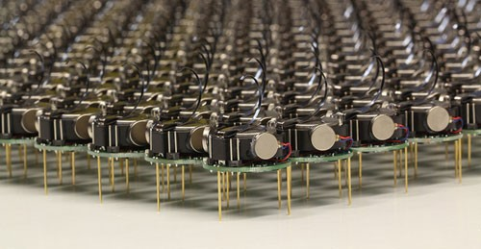
Multi-Agent System (MAS) Definition
A multiagent system is one that consists of a number of agents, which interact
In the most general case, agents will be acting on behalf of users with different goals and motivations with one-another
To successfully interact, they will require the ability to cooperate, coordinate, and negotiate with each other, much as people do

Slide 20
MAS design challenges
How can cooperation emerge in societies of self-interested agents?
How can self-interested agents recognize conflict, and how can they (nevertheless) reach agreement?
How can autonomous agents coordinate their activities so as to cooperatively achieve goals?

Slide 21
Collaborative vs Self-Interested MAS
Collaborative: E.g. agents owned by the same person/organisation.
Agent design can be controlled and made to coordinate
More robust compared to “centralised” system
Agents easy to control: No incentive needed
Self-Interested/Competitive: Each agent works on behalf of someone else
Each agent design different; no control of design of other agents
Each agent pursues own goals
Still need to cooperate
Need mechanisms for resolving conflicts of interest

Slide 22
Link with other disciplines
The field of intelligent agents and multi-agent systems is highly inderdisciplinary
Robotics
Complex Systems Science
Economics
Philosophy
Game Theory
Logic
Social Sciences
This can be both a strength (infusing well-founded methodologies into the field) and a weakness (there are many different views as to what the field is about)

Slide 23
Artificial Intelligence & Agents
Classical Artificial Intelligence (AI) foci on
Algorithms to solve hard decision problems; e.g. planning
Algorithms to interpret complex data; e.g. Machine Learning and Machine Vision
Knowledge representation and reasoning
Agents often combine these techniques
Robotics: vision + planning
Software assistants: machine learning + scheduling
E-Commerce ‘bots’: search + machine learning

Slide 24
Some other views of the field
Agents as a paradigm for software engineering:
Software engineers have derived a progressively better understanding of the characteristics of complexity in software. It is now widely recognised that interaction is probably the most important single characteristic of complex software.
Agents as a tool for understanding human societies:
Multi-agent systems provide a novel new tool for simulating societies, which may help shed some light on various kinds of social processes.

Slide 25
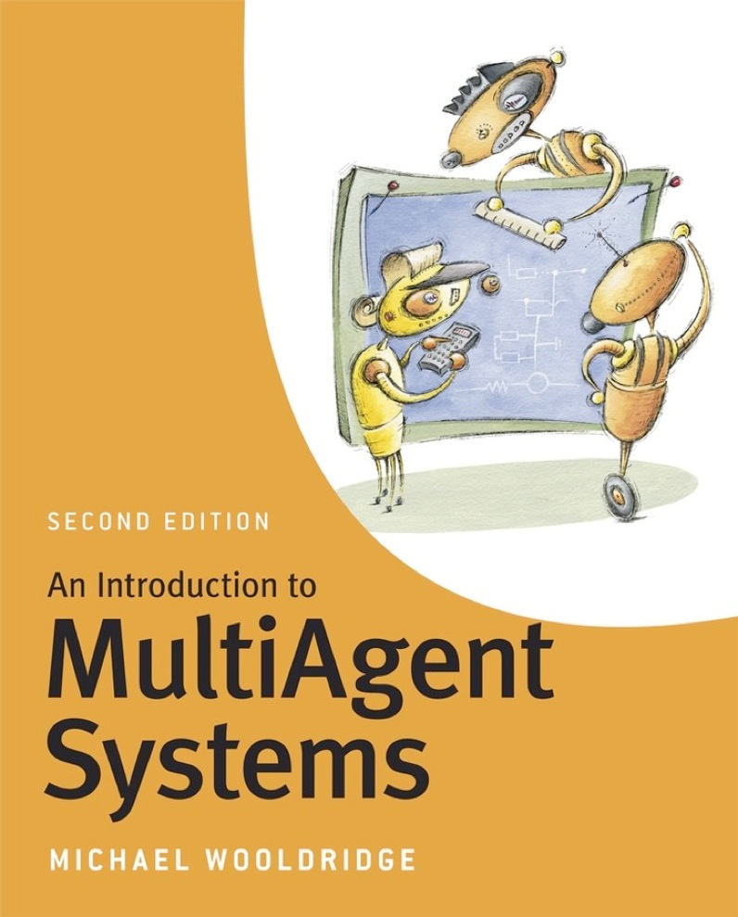
Summary
This has been a brief introduction to Intelligent Agents and Multi-Agent Systems.
We have argued that MAS are:
a natural development of computer science, and
not science fiction
Reading: Chapters 1 and 2 of
Next week: Negotiation

